Slide 1
Pronken met andermans veren
Wat heb je aan wiskunde?
Wat heeft de maatschappij aan wiskunde?
Powered by

Slide 2
Calculus: Affecting the Lives of Millions
Deborah Hughes Hallett Department of Mathematics, University of Arizona Kennedy School of Government, Harvard University
Hands on TI-Nspire Session:
Ann Davidian, MacArthur HS, Levittown, NY
Powered by

Slide 3
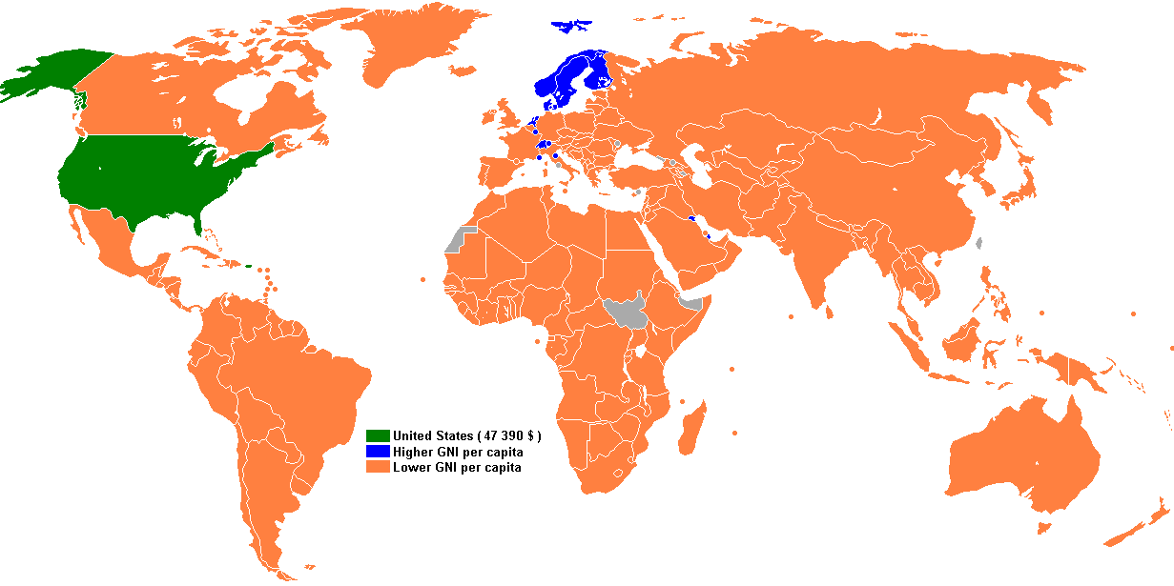
What Does it Take to Maintain Our Economy?
http://en.wikipedia.org/wiki/Economy_of_the_United_States
February 21, 2012:
Wall Street Journal
“Fannie Mae Sees 2012 US Economy Growth Of 2.3%,
Up From 1.6% In 2011”
Feb. 26, 2012: Bloomberg Businessweek
“Manufacturing probably accelerated for a fourth straight month in February, consumer confidence improved and Americans picked up the pace of spending a month earlier…..”
Powered by

Slide 4
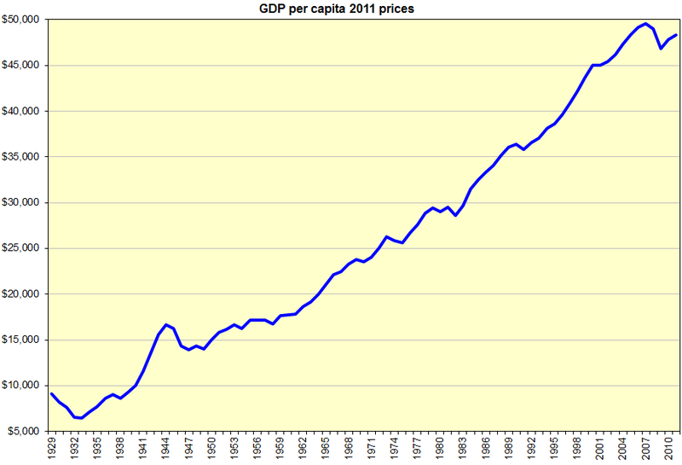
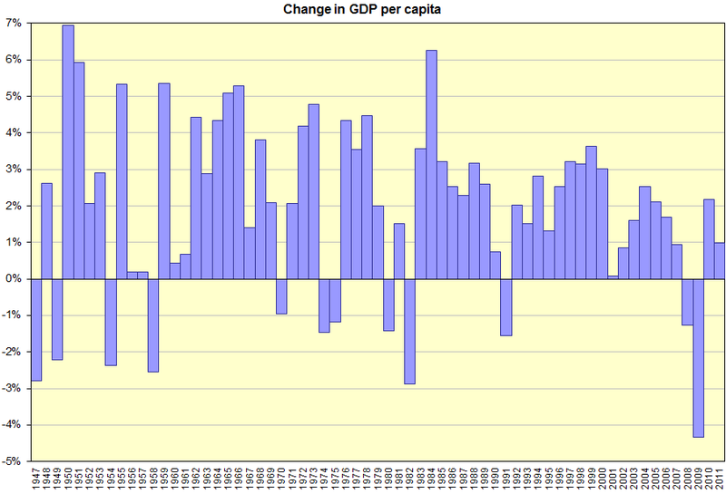
US GDP per capita
If the economy is shrinking, we have a recession
If the economy is not changing, it is stagnant
What does it take to keep the economy expanding?
Powered by

Slide 5
An Expanding Economy Requires More Energy
How long can we increase energy consumption each year?
It depends partly on the source: Supply of oil is finite
What is peak oil production?
When will/did US oil production peak?
When will/did world oil production peak?
Based on Calculus, Hughes Hallett at al, 2009. Uses data at http://cta.ornl.gov/data/chapter1.shtml
http://www.eia.gov/cfapps/ipdbproject/IEDIndex3.cfm?tid=5&pid=53&aid=1
Powered by

Slide 6
What Mathematics Models US Oil Production?
Let P be the total quantity of oil produced in the US since 1859, when the first oil well was built; P is in billions of barrels. Let t be time in years
Then dP/dt is approximately US annual oil production
What is the relationship governing changes in P?
Powered by

Slide 7
Look at Relative Growth Rate: (dP/dt)/P
Exponential growth:
(dP/dt)/P is constant
Can’t hold for long; P would increase indefinitely
Logistic growth:
(dP/dt)/P is linearly decreasing function of P
or
Powered by

Slide 8
What are k and L?
What does k represent?
Exponential growth rate for small P
What does L represent?
Value of P for which dP/dt is zero
Total US oil reserves
How do we estimate k and L?
(dP/dt)/P is linear function of P; use scatter plot and linear regression
Powered by

Slide 9
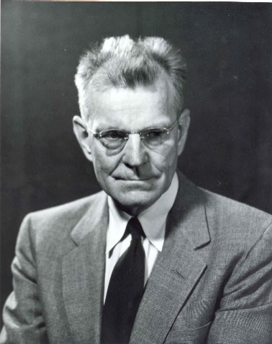
History: M. King Hubbert
In 1956, the US geologist Hubbert gave a paper in San Antonio analyzing US oil production and predicting peak oil.
Using data he would have had gives us:
Powered by

Slide 10
Differential Equation and Solution
We get k = 0.0649 and L = 180 billion barrels
So the differential equation is:
With t = 0 in 1950, and P₀ = 40.9, its solution is the logistic function:
Powered by

Slide 11
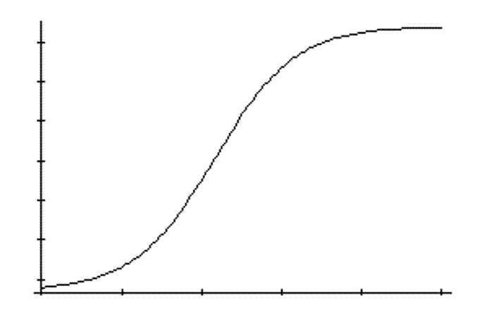
How Do We Find When Peak Oil Occurs?
A logistic curve has the shape shown:
Where is L?
Where is maximum rate?
L
L/2
http://www.jmu.edu/geology/ComplexEvolutionarySystems/ChaosTheory.htm
Peak Oil occurs when P = L/2
Powered by

Slide 12
For Hubbert’s Model
Set the denominator to 2 and solve for t, giving
t ≈ 19.
Since we took t = 0 in 1950, Hubbert’s prediction was 1969. (In fact, he said 1965-70).
What happened about that time? A few years later?
Powered by

Slide 13
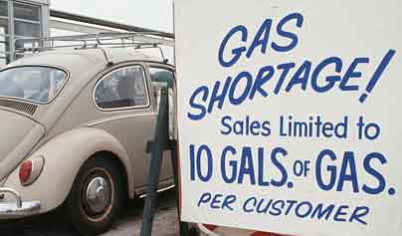
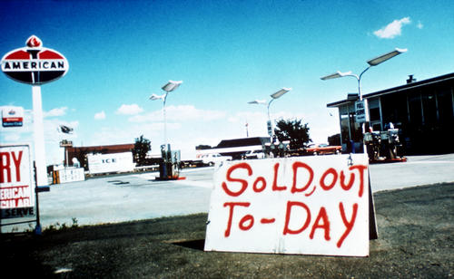
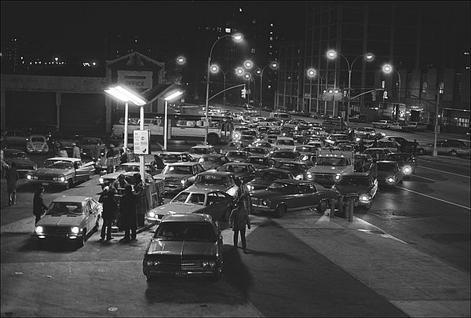
http://www.heatingoil.com/articles/arab-oil-embargo-happened-happen/
http://www.saskschools.ca/curr_content/socst10_05/images/oil_crisis.jpg
Politics played a role too
Later foreign oil imports grew
1970’s Oil Crisis
Gas lines,
Brooklyn 1973
http://artnectar.com/2010/02/1970s-new-york-city-in-pictures/
Powered by

Slide 14
Annual US Oil Production, 1900-2010
Powered by

Slide 15
Total US Oil Production, 1900-2010
Powered by

Slide 16
What is the Calculus Involved in Predicting Peak Oil?
Initial value problem
Solving differential equation using integration Estimating asymptotes and point of maximum slope
Exponentials and logarithms
Regression (involves optimization)
Linear, quadratic, and logistic functions
Powered by

Slide 17
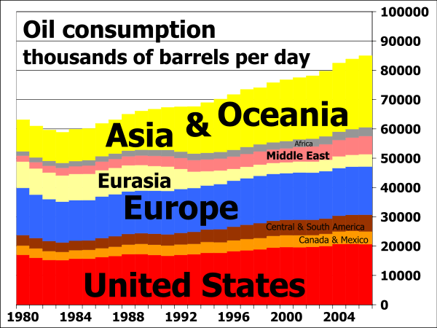
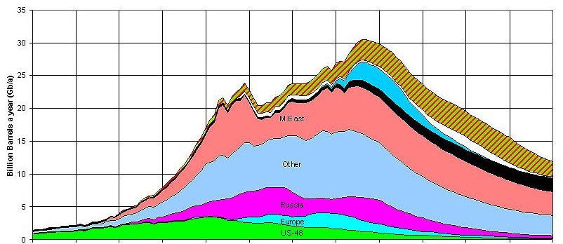
When is World Oil Predicted to Peak?
Production: All liquid Fossil Fuels, bn barrels per year http://planetforlife.com/oilcrisis/oilpeak.html
http://en.wikipedia.org/wiki/Peak_oil
Powered by

Slide 18
Commemorating Hubbert’s Willingness to Announce What He Saw in the Mathematics http://www.mkinghubbert.com/ and http://www.thecuttingedgenews.com/index.php?article=476
“In 1950, the United States was largely self sufficient on oil. It was the world’s largest producer and exporter of oil.……She had just emerged relatively unscathed from of the second of two world wars for which her unprecedented access to oil proved the deciding factor. …...The sun was rising on America…….”
“In this context of American exuberance and seeming mastery of the world, M. King Hubbert took a stand ….. forecasting that the ultimate source of American power—oil—Texas gold—was headed for imminent decline—and he did it in the heart of the oil patch.”
"Our ignorance is not so vast as our failure to use what we know.“ M. King Hubbert
Powered by

Slide 19
Mathematics can be used to improve the lives of millions, all over the world
Powered by

